Slide 1

Classification Model with 83% Accuracy – Bank Dataset
12 April 2025
by Ahmad zaki bin ramli

Slide 2
Project Overview
Problem Statement
Focus: Predict whether a customer will subscribe to a term deposit.
Data Content: Includes customer demographics, previous campaign contacts, and subscription outcome.
Main Goal: Build a predictive model to support targeted marketing strategies.
Bank marketing campaigns often lack precision in targeting the right customers.
Ineffective targeting leads to wasted resources and low conversion rates.
Key challenge: Identify customers likely to subscribe using historical and demographic data.
Objective
Data Understanding & Cleaning
Explore trends, detect anomalies, and handle imbalanced features
Ensure no missing values and clean redundant features
Feature Engineering
Encode, Scale and Multikolinearity analysis
Model Building
Run model and Evaluate

Slide 3
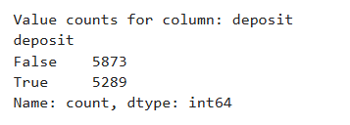
( 11,162,17 )
Exploratory Data Analysis
(16)
(1)
X = FEATURE
Y = TARGET
Age
Job
Martial
Deposit
Education
Default
Balance
Housing
Loan
Contact
Day
Month
Duration
Campaign
Pdays
Previous
Poutcome
Shown balance dataset

Slide 4
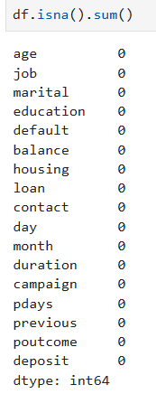
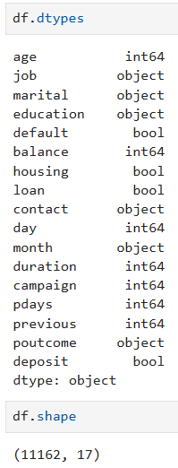
Inspection Datatypes, Missing Values
Exploratory Data Analysis
Don’t have any missing values
checking the following parts of the data for an initial review :
Datatypes
Missing values
Data types and shape

Slide 5
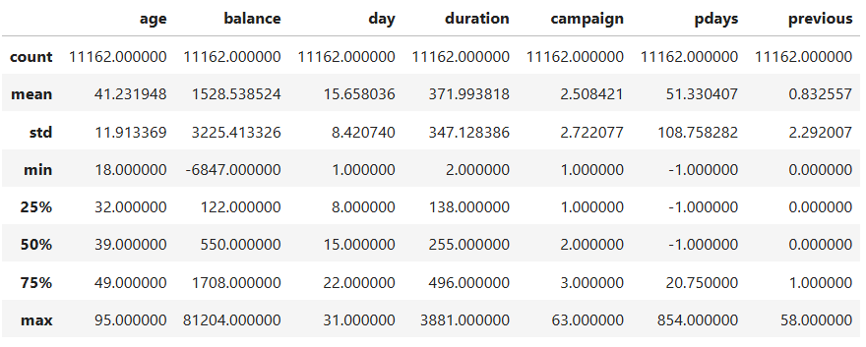
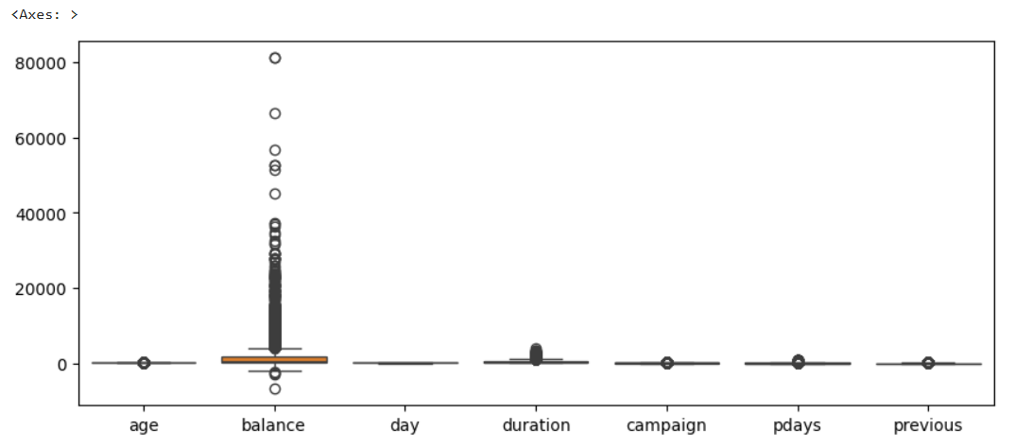
Anamolies Detection
Basic statistic
Explanation
Outliers detected in `balance` via boxplot, but retained due to business logic (income variation).

Slide 6
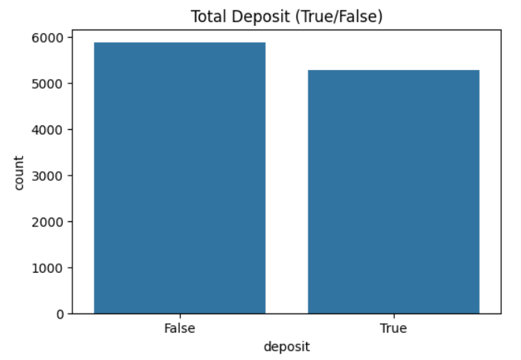
Exploratory Data Analysis
Explanation

Slide 7
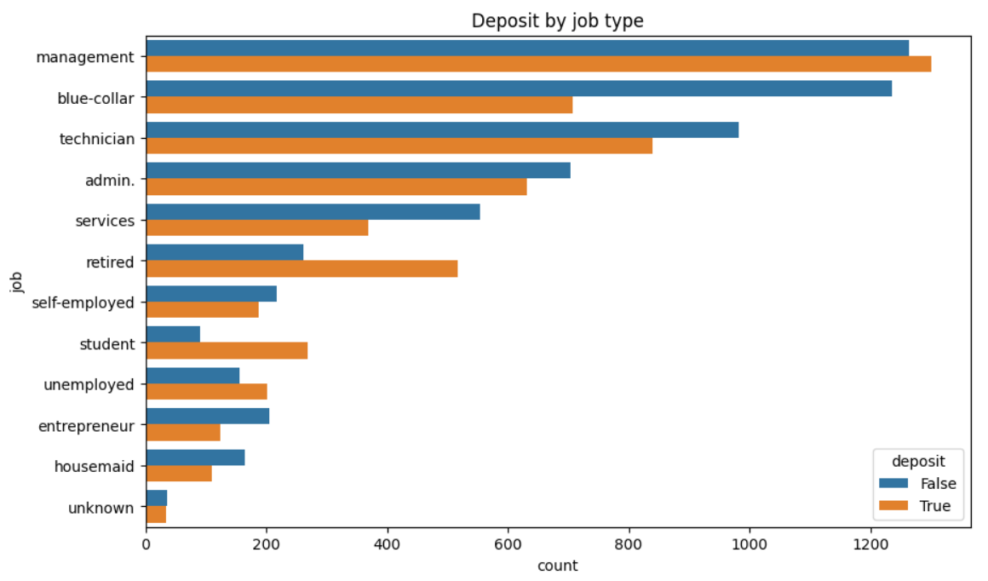
Exploratory Data Analysis
Explanation
The majority of customers who subscribed to the term deposit are from the Management and Blue-collar job categories

Slide 8
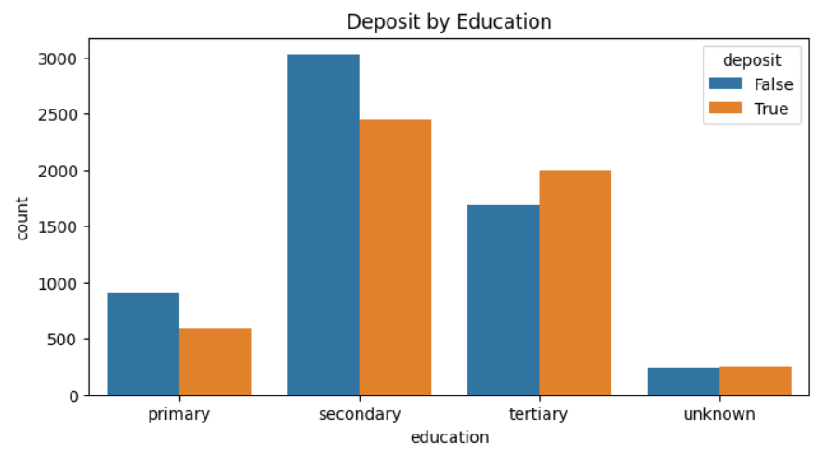
Exploratory Data Analysis
Explanation
The highest number of deposit subscribers come from individuals with a secondary education

Slide 9
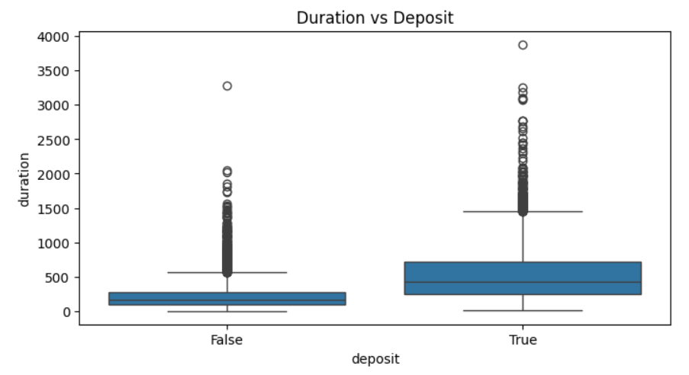
Exploratory Data Analysis
Explanation
The highest number of deposit subscribers come from customers with long call durations

Slide 10
Exploratory Data Analysis
Explanation
The highest number of deposit subscribers come from customers with long call durations

Slide 11
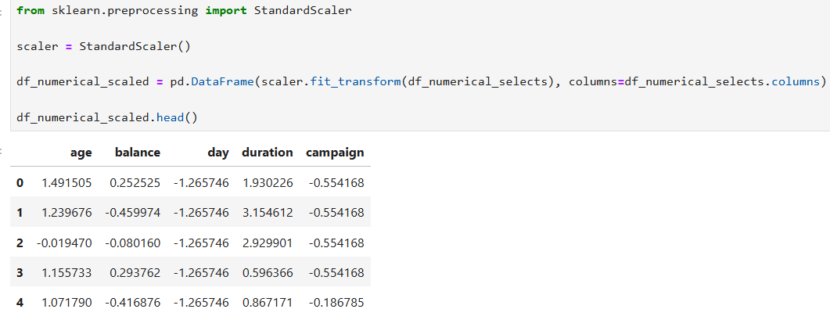
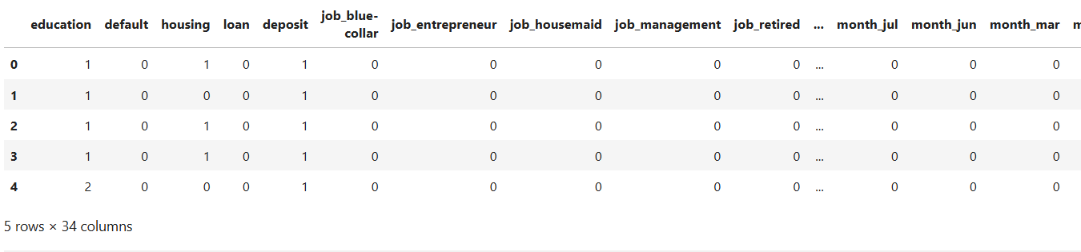
Encode & Scale
Scaling (Standardscaler)
Using Label Encoding & One Hot Encode

Slide 12
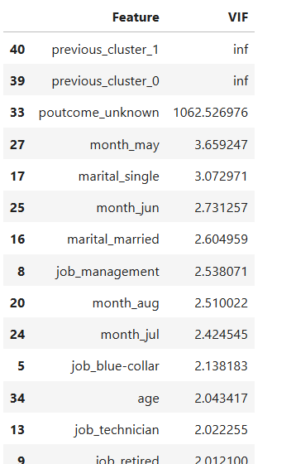
Multikolinerity Analysis
Show redundant features

Slide 13
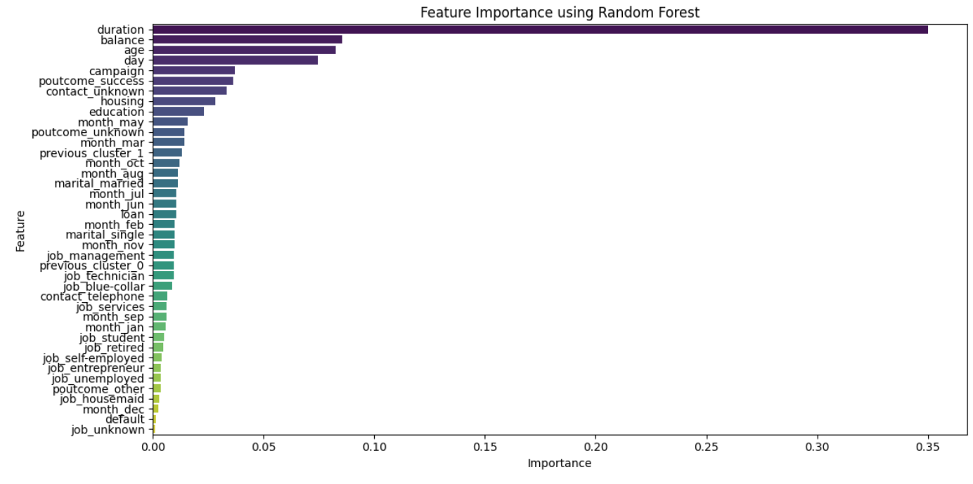
Feature Importance
Top Feature Impotance
Explanation
The most important features influencing deposit prediction are the duration of the call (35.02%), with longer calls increasing deposit likelihood, followed by account balance (8.54%), age (8.25%), the day of the month (7.45%), and the number of campaign contacts (3.70%).

Slide 14
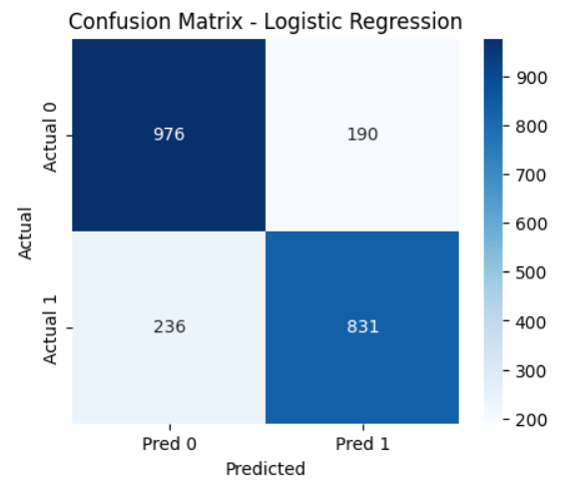
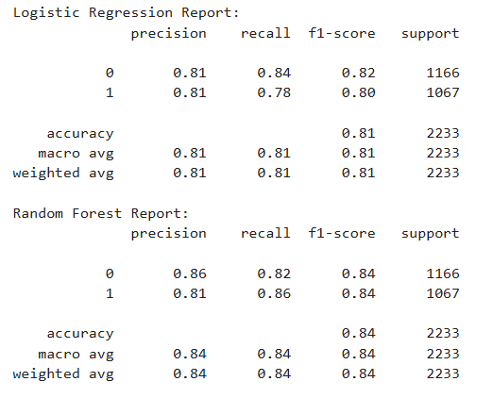
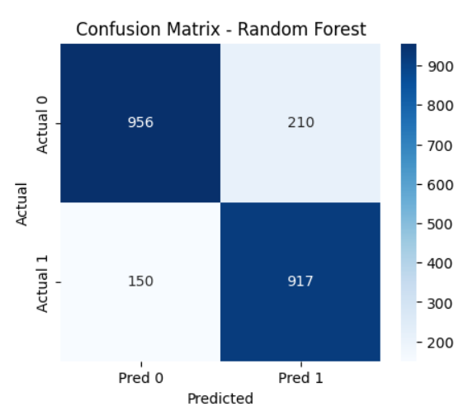
Predictive Modeling
Result for each model
Evaluation for Random Forest with 84% Accuracy

Slide 15
Highlight of Findings
1) Customer Demographics and Deposit Subscription:
The majority of deposit subscribers are from Management and Blue-collar job types, which suggests that these customer groups may be more
financially stable and likely to engage in bank deposit services.
2) Secondary education
appears to be the dominant educational level among deposit subscribers, indicating that customers with this level
of education may be more inclined to save or invest through bank deposits.
3) Influence of Call Duration:
Longer call durations have a positive correlation with deposit subscriptions. This suggests that more extensive interactions or consultations
with customers increase the likelihood of them subscribing to a deposit product, likely due to better customer engagement and understanding of the product.
4) Feature Importance and Predictive Accuracy:
Key features influencing deposit subscription include duration, balance, and age. Longer interaction times (duration), higher balance, and
age are strong indicators of deposit subscriptions.
The Random Forest model achieved an accuracy of 84%, demonstrating that the model effectively predicts deposit subscription based on
the selected features.
5) Feature Redundancy and Preprocessing:
pdays and previous were identified as redundant features, as they conveyed similar information. By clustering and simplifying these features,
model became more efficient.
Feature scaling and encoding techniques, such as StandardScaler and One-Hot Encoding, were employed to improve model performance.
.

Slide 16
Conclusions
By leveraging data-driven models, banks can significantly improve the targeting of marketing campaigns, ensuring resources are focused on high-potential customers. The analysis demonstrated that key factors like call duration, balance, and customer age contribute to a higher likelihood of deposit subscription. With an accuracy of 84%, the Random Forest model proves to be an effective tool for predictive analysis, offering a foundation for more precise and efficient customer targeting in future marketing campaigns.

Slide 17
Thank You For Your Time !

